Slide 1

DriverPass System Analysis
April Milam
Notes:
Hello everyone good morning/afternoon/evening (depending on time of day being presented. How is everyone today? My name is April Milam and I’m here to show you some of the key things we have been working on for the DriverPass website. As we go through the presentation, please let me know if you have any questions, comments or concerns.

Slide 2

System Requirements
Functional Requirements
The system shall have DMV (Department of Motor Vehicle) update continuously with updated message on the home screen.
The system shall have the compatibility to modify appointments.
Nonfunctional Requirements
Designing the system to have cloud-based storage and access.
Computer and mobile friendly web design for Apple, Windows or Android devices.
Notes:
System Requirements are one of the key features that help us determine what is functional and nonfunctional system requirements for DriverPass. We have highlighted a couple important ones to go over at this point in time.
Functional requirements are the brains of the system this is how the system preforms and behaves. Comparable to how our brains tell our body how to function.
The key functional features that we took from the interview were that the system needed to have continuous updates from the DMV (Department of Motor Vehicle). Having this information will help the costumer and website stay updated with the most recent information.
On the design part of the DMV updates, we would like for there to be an option on the homepage that shows when an updated has occur. This will help users see the updates and know when the last updated happened.
Another key feature is having the user and/or secretary be able to modify appointments online. The modifications will allow users to reschedule, cancel or modify their reservations without having to come in or call. The secretary will also have access to these changes when someone in new and have not setup their user account or when they needs help making the adjustments.
Nonfunctional requirements are our design elements on how we want the system to preform. Think about when you exercise and cut crabs out your energy level is lower verse when you have carbs then exercise. We want the system to have a high-performance level.
Designing the website having cloud storage allows for an expandable storage. This will help limit worrying about the computers not being able to run the data. This will also help the business expand to other city and states giving more people access to DriverPass.
The cloud storage will also allow us to have a website that is computer and mobile friendly. This way if the costumer does not have access to a computer, they can use their mobile device or tablet. The mobile feature will cater to all Apple, Android and Windows based platforms. In the office this helps reduce the cost on computer hardware due to not having to worried about if the computer meets certain requirements to run the program or the storage of all the data.

Slide 3

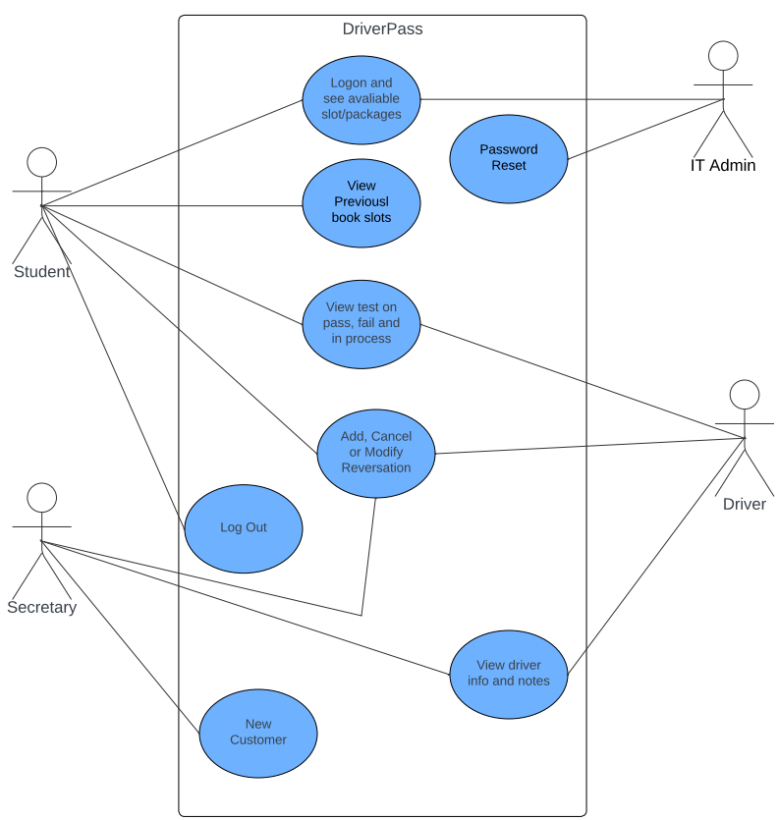
Use Case Diagram
Notes:
This is a Use case diagram when just looking at it seems like we doodle some boxes with circles, lines and stick figures that a kid could do. This is the outline of how the system will run and help us visualize the program that we are creating.
In the diagram the stick figures are actors, and they are the users of the system. The bubbles are the functions of the system, and the lines are the way the user will interact with the system. The box around the bubbles is the database and hold everything together.
The Student will logon and have the option to see what packages are available and what slots for reservations. They will also be able to view previously booked slots. We have the option for the student to view test that have been taken and see if they have passed, failed or what is still in progress. After, that they will have the option to add, cancel or modify all reservations. Having the log out feature will enhance security measure too.
The Secretary will have the options to modify any reservations by adding, canceling or updating. They will also be able to see the driver information on who is assigned to which vehicle and in which car for all reservations. When a new customer calls in to inquiry about DriverPass the secretary will set up their information in the system and provide them with a PIN number to access their account.
IT Admin will be over all login access and be able to update any information including turning on or off any package. They will be the only ones that can reset anyone’s password.
The driver will have access to view all test information to help provide feedback to the customer and see all reservations. They will be able to update reservation information when needed. Having the driver notes and information will help keep track on how the customer is doing and provide information on what they may need to focus on more. View which driver has what car on certain days will help with scheduling information.

Slide 4
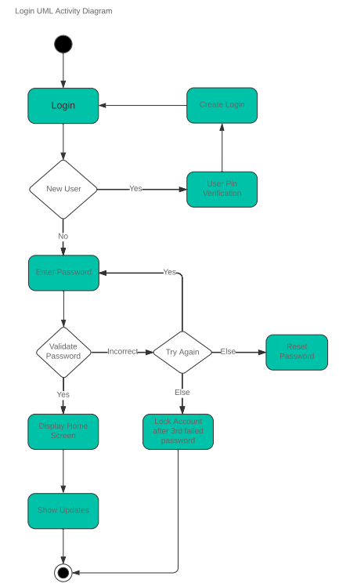
Activity Diagram
Notes:
The activity diagram might have a Tetris design with the boxes and diamonds are on the screen looking like one big puzzle.
The diagram demonstrates how the information for process in the system. The starting point in the black circle. The user will have the option to login if they are a current user or create a login. If the user clicks on the new customer the system will ask for the security pin that was provide by the secretary. Then will be able to login just like a prior customer. The system will prompt the user for their password. If the user provides the correct password, it will take them to the display screen and show any new updates. If the user enters the incorrect password they can try again, but after the 3rd failed attempt, it will lock the user out of the account. The user will also have the option to reset their password if needed. Once, they enter the corrected password it will take them to the display screen and show the updates.
Having this diagram helps us see if there is an important set that might be missing or if we are over complicating the system.

Slide 5

Security
Password must be updated every six months without using the same last 6 password.
Password must be 8-12 characters long with at least one special character and one upper case and lower caser letter.
Users can recover username or forgotten password.
Lock the user out if there are too many failed attempts on incorrect password that only IT Admin can unlock.
Automatic sign out when user stay logged on for extend period greater than 4 hours.
A private or hybrid cloud base domain
Encrypted emails and data
Notes:
Having a good security system in place will help reduce the risk of a security breach.
All employees will have to update their passwords every six months to help reduce password sharing or someone using another employee's username and password. This keeps someone out of things they do not have access to based of their job title.
Making a standard setting for requirements on all password for employees and customers will prevent potential threats. This will also include a password strength for the person to help them create strong passwords.
The IT Admin will have to option to help a customer or new employee with forgotten username and/or password. To add extra measure on the username we may have the customer call in for the new PIN number, so we are able to verify the user. When is comes to the password we will have a two-step verification as well.
The customer/employee will be locked out of all systems if the password is entered incorrectly after the 3rd try and their account will be locked. IT will be the only ones that will be able to unlock the accounts.
Automatic sign out after 4 hours of no activity in cases the customer forgot to logout on a public computer system.
Having a private or hybrid cloud base domain will help with security for all stored data to ensure no one’s personal information is leaked.
Encrypted emails and data that are stored in the cloud to help provide additional protection.

Slide 6

System Limitations
System can only be used online.
Only be able to use with local USA DMV.
System will not have the ability to update packages due to IT constraints.
Budget could be a concern with only using cloud storage as the company grows.
Technology of mainly using a computer and not having an app for people that are on the go, especially the younger generation.
Notes:
System Limitations might be a challenge especially in a new program or website because we are trying to expect the unexpected.
Having a system with only online access might be hard for some customers due to not having home internet. Also, reading some of the martial should have the option for offline reading. This will allow the customer to study the DMV martial offline.
Only accessing the USA DMV may make it harder for the international people that do not understand the rules and regulations verse the county they might be from. Sometimes it might be easier for them to compare the difference between the two to help them understand why the rules and regulations are different.
Not having the option at this point time to update packages due constraints. This is something that we want to work towards building an enhancement later to allow those options to be made.
The cloud budget as the company grows it will need more storage for the data. We would recommend a purging of the data greater then five years old.
If the website is mainly computer based without an app design, it could hurt the company when it comes to the younger generations. Most of the younger generation understand phones and tablets more then a computer which could limit the way the system is provide and used for some customers.

Slide 7

Questions???
Notes:
I would now like to open the room for any additional questions, comments or concerns.
As always thank you for you time today.

